Slide 1
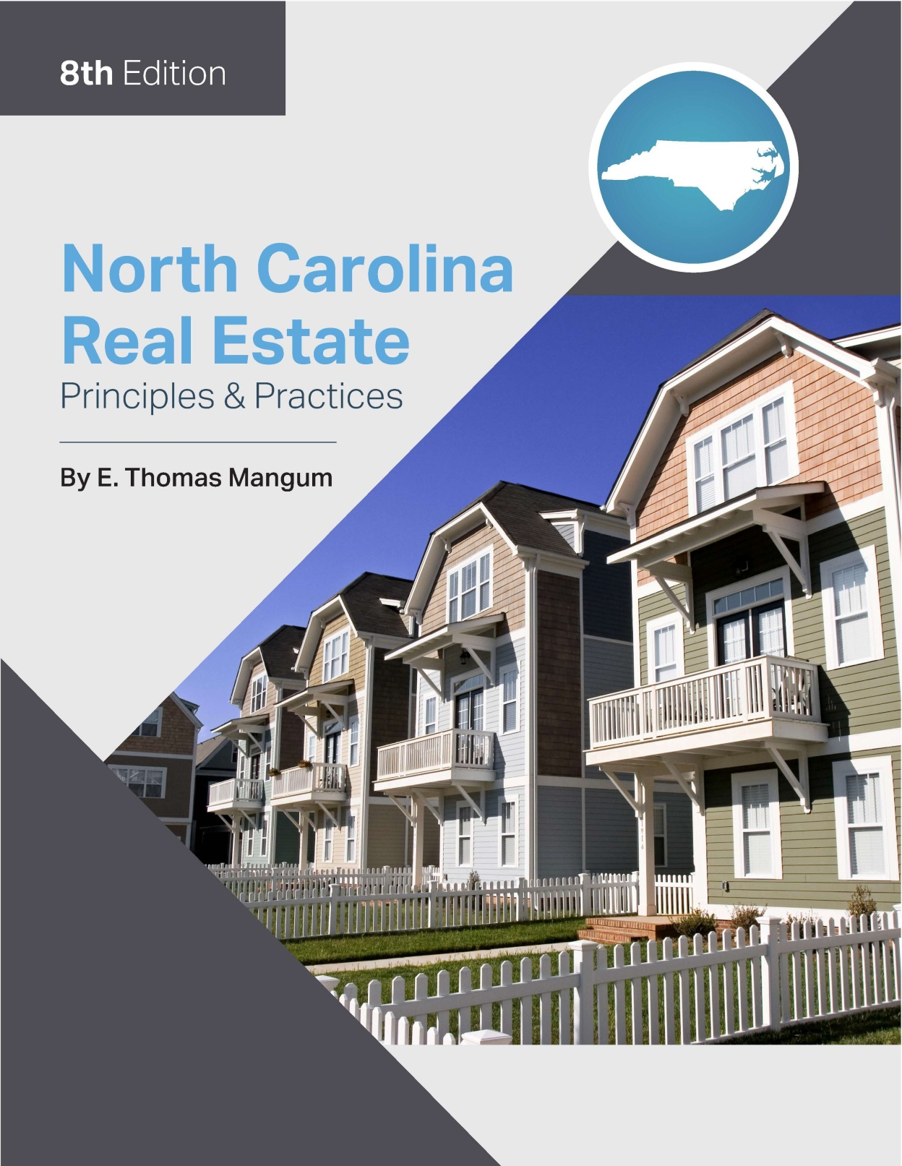

Slide 2
Chapter 13
Real Property Valuation
Learning Objectives
Define the basic terminology of valuation
Define the basic concepts of value, including appraisal, evaluation, valuation, value in use, and market value
Describe the forces and factors that affect value
Describe the economic principles of value
Define the basic terminology of appraisal methodology
Describe the general use and procedures of the direct sales comparison or market data approach. Make simple adjustments to comparable properties to derive an indication of a subject property’s value

Slide 3
Chapter 13
Real Property Valuation
Learning Objectives
Describe the general use and procedures of the cost approach
Describe the general use and procedures of the income approach
Understand the laws and rules governing the performance or Broker Price Opinions (BPO) and Comparative Market Analysis by brokers
Understand how to properly perform BPO/CMA of a single-family residential property

Slide 4
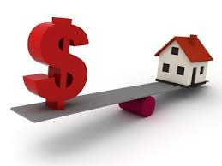
Chapter 13
Real Property Valuation
Appraiser Regulation
Licensure and Certification
Financial Institutions Reform, Recovery, and Enforcement Act (FIRREA)
requires licensure and certification of appraisers
regulatory system for appraisers of property connected with federally related transactions
North Carolina Appraisal Board
mandatory licensing and certification program
licenses or certifies appraisers

Slide 5
Chapter 13
Real Property Valuation
Basic Appraisal Concepts
Definition of Appraisal:
estimate of the value of real property
North Carolina Appraisers Act defines an appraisal as “An analysis, opinion, or conclusion as to the value of identified real estate or specified interest therein performed for compensation or other valuable consideration.”
Broker Price Opinion/Comparative Market Analysis (BPO/CMA):
Not to be confused with “appraisal”
North Carolina Appraisers Act defines BPO/CMA as “the analysis of sales of similar recently sold properties in order to derive an indication of the probable sales price of a particular property by a licensed real estate broker.”
Only active “non-provisional” broker licensees may perform CMA/BPO for a fee.

Slide 6
Chapter 13
Real Property Valuation
Basic Appraisal Concepts
Valuation vs. Evaluation
Valuation:
estimating what the average buyer would pay for a property
fair market value
Evaluation:
economic feasibility of and land utilization for particular projects
Economic feasibility is concerned with the workability of a project such as the development of a residential subdivision, office project, or shopping center.
A land utilization study determines the best current use of a property.

Slide 7
Chapter 13
Real Property Valuation
Additional Concepts of Value
Demand:
desire or need for property
coupled with the financial ability to satisfy that need
Utility:
ability to satisfy a need
must be possible to use or adapt the property for some legal purpose
Scarcity:
supply of real property in relation to the effective demand for the real property
abundant supply of property=lower value
limited supply of property = higher value

Slide 8
Chapter 13
Real Property Valuation
Additional Concepts of Value
Transferability:
must be present for the property to have value
makes it possible for the owner to transfer the ownership interest to a prospective buyer
Forces and Factors Influencing Value
Social ideas:
Public attitudes about education
Cultural activities
Recreation
Demographics:

Slide 9
Chapter 13
Real Property Valuation
Forces and Factors Influencing Value
Economic forces:
Employment and income levels
Availability of consumer credit
Interest rates and price levels
Amount of real property taxes
Government activities:
Zoning and building codes
Fire regulations, city and county planning
Regulations designed to promote or deter economic development
Physical forces:
Natural forces, size, shape, soil conditions, mineral resources, climate
Location, public transportation, access, proximity to streets and highways

Slide 10
Chapter 13
Real Property Valuation
Basic Economic Principles of Value
Supply and Demand:
the greater the supply, the lower the value
the smaller the supply, the higher the value
Anticipation:
Value is based on the anticipation of the future benefits of ownership.
Substitution: foundation of direct sales comparison approach
Cost of purchasing or constructing another property of equal utility and desirability
Assumes substitution can be made without unusual delay
Conformity:
Homogeneous or compatible uses of land within a given area
Contribution:
something is worth relative to what it contributes to overall value

Slide 11
Chapter 13
Real Property Valuation
Basic Economic Principles of Value
Competition:
When the net profit generated by a property is excessive, the result is to create more competition.
Change:
Continually affecting land use/value
Re-evaluate the value of listed properties periodically.
Highest & best use:
“that possible and legal use or employment of land that will preserve its utility and yield a net income flow in the form of rent that when capitalized at the proper rate of interest, forms the highest present value of the land.”
may change over time.
must be physically possible, legally permissible, and financially feasible

Slide 12
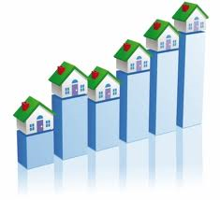
Chapter 13
Real Property Valuation
The Valuation Process
Define the appraisal problem:
purpose and type of value to be determined
Obtain a complete and accurate description of the property:
Limits of the area must be specified in the description
Inspect the surrounding area and the property to be appraised.
Determine the specific data required as a basis for the value estimate:
Perform a highest & best use analysis
Analyze the data and arrive at a value estimate by three appraisal methods:
Market data, Cost and Income
Reconcile the results obtained by the three methods and
determine value estimate.
7. Prepare the appraisal report

Slide 13
Chapter 13
Real Property Valuation
Approaches to Value (Appraisal Methods)
The Sales Comparison (Market Data) Approach
Compares subject property to similar properties sold recently
The Cost Approach
Theoretically rebuilds the structure anew and then adjusts it to it’s present condition
The Income Approach
Applies the capitalization formula to the income (rent) produced

Slide 14
Chapter 13
Real Property Valuation
Approaches to Value
Sales Comparison (Market Data) Approach:
Primary approach for estimating the value of single-family owner-occupied dwellings and vacant land.
Based on the premise that the best way to determine value is to compare what similar properties are being sold for.
Allowances are made for the differences by following the principle of contribution.
Key points about Sales Comparison Approach:
Subject – is the property being appraised
Comparable (Comps) – similar properties that have been recently sold in the marketplace preferably in past six months and reasonably close by

Slide 15
Chapter 13
Real Property Valuation
Approaches to Value
Key Points about Sales Comparison Approach
Three to four comps are sufficient – never less than three
Comparables should be verified, closed out sales prices – not asking price
You only adjust comparables, never the subject
Reconciliation – weighted average of adjusted sales prices to determine a single
estimate of value
The Cost Approach:
Primary method for estimating the value of properties when there are not sufficient comparable sales or properties that do not produce rental income
Unique properties such as schools, fire stations, libraries, etc.

Slide 16
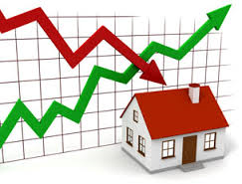
Chapter 13
Approaches to Value
The Cost Approach
Procedure for estimating value for cost approach:
Estimate construction costs to replace or reproduce the improvements
Estimate total accrued appreciation of improvements
Subtract depreciation of improvement from construction costs to determine the value of improvements
Estimate the value of land using sales comparison method
Add the lot value to the value of the improvements to determine the appraised value

Slide 17
Chapter 13
Approaches to Value
The Cost Approach
Estimating Replacement/Reproduction:
Reproduction cost -constructing an exact duplicate of the property when new
based on constructing a building of comparable utility using modern building techniques and materials
Estimate construction costs to replace or reproduce improvements by:
Quantity survey method:
most accurate
most complex and time consuming
most builders use to calculate a cost estimate for a construction job

Slide 18
Chapter 13
Approaches to Value
The Cost Approach
Estimating Replacement/Reproduction Costs:
Unit in place method:
Less detailed
Cost of each component part of the structure is calculated
Cost per square foot method:
Calculated by multiplying the number of square feet in the structure being appraised by the cost per square foot to construct the building using the current cost per square foot

Slide 19
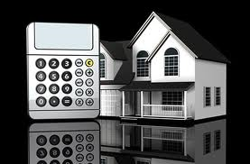
Chapter 13
Approaches to Value
The Cost Approach
Estimating Replacement/Reproduction Costs:
Direct sales comparison approach:
Add the lot value to the value of the improvements to get the appraised value.
Deduct depreciation resulting from any cause from the estimated cost of replacing or reproducing the property.

Slide 20
Chapter 13
Approaches to Value
The Cost Approach
Estimating Depreciation- an actual loss in value from any cause
Age/life (Straight line) method:
Ratio between effective age and economic life
Divide the effective age by the economic life to determine the depreciation
Economic life:
Period of time during which the improvement can profitably utilized
Chronological age:
Effective age:
Age the structure appears to be based on its’ condition
Remaining economic life (Useful):
Number of years it has left from the time of the appraisal to the end of its useful life

Slide 21
Chapter 13
Real Property Valuation
The Cost Approach
Estimating Depreciation
Market abstraction method:
More objective and analytical method than age/life (straight line)
Assumes that replacement costs of comparable properties minus their sales prices approximate the cumulative depreciation
Breakdown method :
Physical deterioration
Functional obsolescence
Economic obsolescence

Slide 22
Chapter 13
Real Property Valuation
The Cost Approach
Estimating Depreciation
Physical Deterioration:
Unrepaired damage to the structure caused by fire, explosion, vandalism, windstorm, or damage caused by termites or other wood-boring insects
wear and tear when adequate maintenance measure are not taken to keep the property in good condition
wear and tear on short-lived items even when adequate maintenance is performed.
items serve their original purpose and it may not be practical to replace them.
Can be curable (item worth repair) or incurable (item that will cost more to repair than it’s contribution to value)

Slide 23
Chapter 13
The Cost Approach
Estimating Depreciation
Functional obsolescence:
Inadequacy or over adequacy of: wiring, plumbing, heating and cooling systems
Insufficient or over sufficient number of bathrooms, closets, and other facilities
Equipment that is out of date and not in keeping with current style and utility
Exposed wiring or plumbing and lack or automatic controls for such things as furnaces and hot water heaters
Faulty design resulting in:
Inefficient use of floor space
Poor location of rooms in relation to other rooms
Such things as ceilings being too high or too low
Can be curable or incurable

Slide 24
Chapter 13
Real Property Valuation
The Cost Approach
Estimating Depreciation
Economic obsolescence:
Caused by forces outside the property itself (external)
Always incurable:
Changes in surrounding land use patterns
Changes in zoning and building regulations that adversely affect property use
A reduction in demand for property in the area caused by local economic factors, changes in growth patterns, population shifts, and other economic factors adversely affecting property value

Slide 25
Chapter 13
Real Property Valuation
The Income Approach
primary approach to appraising income producing property
Capitalization:
The process of converting net operating income into value.
Capitalization (CAP) rate – is the % of value the investor wishes net operating income to be.
Net operating income:
Income projected after deducting losses for vacancies, collection losses and expenses, and operating expenses.
Operating expenses do NOT include mortgage interest, depreciation, or the cost of capital improvements.

Slide 26
Chapter 13
Real Property Valuation
The Income Approach
The operating statement:
Business financial statement that lists:
revenues
expenses
net income
AKA Profit and loss statement, earnings report, earnings statement or income statement
The capitalization formula is used to estimate the value of an income producing property. The formula is as follows:
Income = Rate x Value
Net operating income is always used in the capitalization formula.

Slide 27
Chapter 13
Real Property Valuation
Approaches to Value
Gross Rent Multipliers (GRM):
Not part of the income approach to the value estimate
May be used to estimate the value of property producing rental income
Not as accurate as the income approach
The more efficiently property has been managed, the more reliable is the GRM
The more “out of line” the expenses, the less reliable the GRM

Slide 28
Chapter 13
Real Property Valuation
Reconciliation and Appraisal Report
Reconciliation:
Use most relevant approach as primary appraisal method:
Single-family owner-occupied residential and vacant lots: Direct Sales Comparison Approach
Income producing (rental): Income Approach
Unique or special purpose buildings: Cost Approach
Use all three approaches, but give the most relevant approach the highest weight.

Slide 29
Chapter 13
Real Property Valuation
Reconciliation and Appraisal Report
Preparing the Appraisal Report:
Final step in appraisal process
Contains appraiser’s opinion of value based on his findings
May be:
A narrative report
A form report
Presents all factual data
Discusses judgment appraiser used to arrive at his conclusion

Slide 30
Chapter 13
Real Property Valuation
Broker Price Opinion (BPO)/Comparative Market Analysis (CMA)

Slide 31
Chapter 13
Real Property Valuation
Broker Price Opinion (BPO)/Comparative Market Analysis (CMA)

Slide 32
Chapter 13
Real Property Valuation
Broker Price Opinion/Comparative Market Analysis
Standards for CMA/BPO
Broker must have knowledge of the real estate market in the area the property is located.
Broker must have sufficient data to research past sales and prices of similar properties.
Broker must exercise objective and independent judgement.
Broker must use proper methodology for any assignment to determine appropriate sales price.

