Slide 1
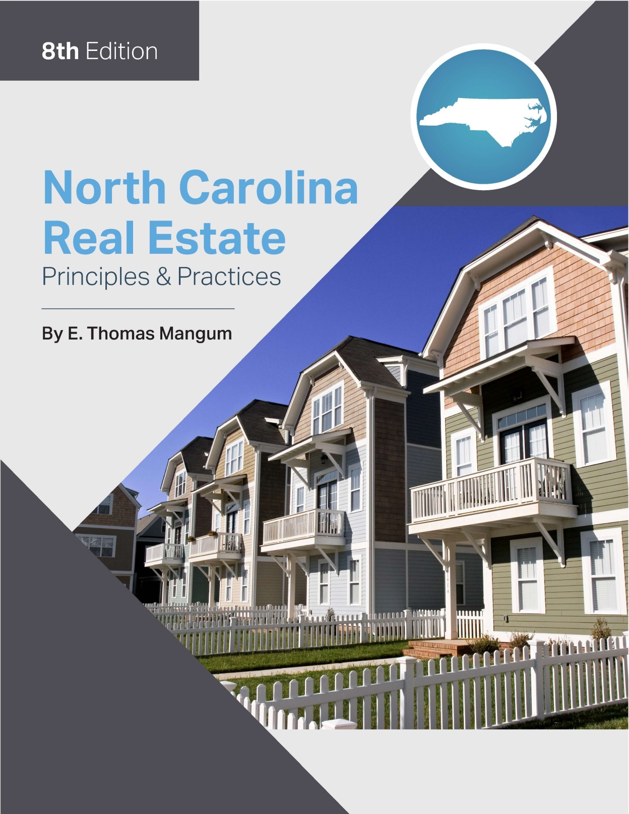

Slide 2
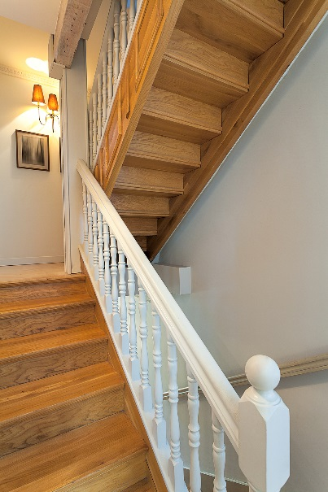
Chapter 19
Basic Construction
Learning Objectives
List the primary styles of residential architecture.
Describe the major components of residential construction, including foundation systems, framing, walls, ceiling and roof, windows, insulation, interior finishes, and heating/cooling systems.
Describe government regulation of residential construction.

Slide 3
Chapter 19
Basic House Construction
Architectural Types and Styles

Slide 4
Basic Construction
Foundations
Footings
most important building block of home
supports foundation wall
concrete base below frost line
Foundation Walls
May be poured concrete, masonry or brick
Piers
Additional structure built inside foundation walls

Slide 5
Basic Construction
Framing

Slide 6
Basic Construction
Framing
Framing is the wooden skeleton of the home.
See figure 19.2 and 19.3 in text
Flooring
Sill
Flashing
Girder
Sheathing
Joists
trusses

Slide 7
Basic Construction
Framing

Slide 8
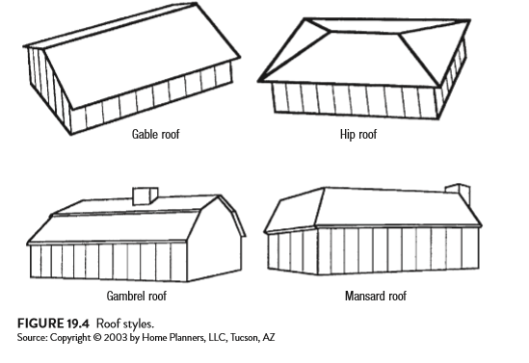
Basic Construction
Walls
Studs- Vertical framing
2 by 4’s
2 by 6’s
Ceiling Framing and Roof
ridge board
soffit
fascia
frieze board
eaves

Slide 9
Basic Construction
Exterior Walls
R-Factor- resistance to heat transfer
sheathing- strengthens walls
plywood
particle board
siding- prevents water damage
Aluminum, manufactured hardboard
Vinyl, stucco, cement board
Brick, wood
weepholes

Slide 10
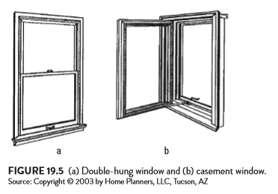
Basic Construction
Windows
3 Types
Vertical Sliding (double hung)
Most common type in residential construction.
2. Swinging (Casement)
limit space (swing inward or outward)
do not insulate well
3. Fixed
picture, bay, bow

Slide 11
Basic Construction
Doors
Interior
wood or composite material
Exterior
maximum insulation desired
wood or steel
high insulating core
Roofing
What type of materials are used in North Carolina?

Slide 12
Basic Construction
Insulation
Primary purpose:
resist flow of heat from one area to other
prevents heating loss in winter
protects against heat load in summer
Used on ceiling, walls and floor
North Carolina Uniform Residential Building Code requirements for R-value:
Walls- R-13
Ceilings- R-30
Floors- R-19

Slide 13
Basic Construction
Moisture Control
Vapor barrier should be installed on inside wall side of insulation
Heating/Air Conditioning Systems (HVAC- Heating, Ventilation, Air Conditioning)
Central unit- only efficient system
Gas- forced air or electric furnace?
Heat pump
Efficiency and operating costs vary.
Agent must correctly identify type of HVAC system when listing or selling property.

Slide 14
Basic Construction
Solar Heat
Passive or Active?
Provide only 50-60% of heat needed for home.
Electrical Systems
Note voltage of wiring, dedicated breakers and smoke detectors.

Slide 15
Basic Construction
Plumbing Systems
Adequacy and quality are important.
Separate shut off valves
Proper venting
Size and insulation of water heater

Slide 16
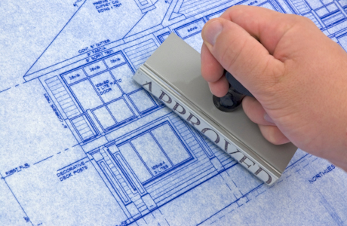
Chapter 19
Basic Construction
Governmental Regulation
North Carolina Residential Building Code
Certificate of Occupancy
FHA/VA Minimum Standards
Contractor Licensing

