Slide 1
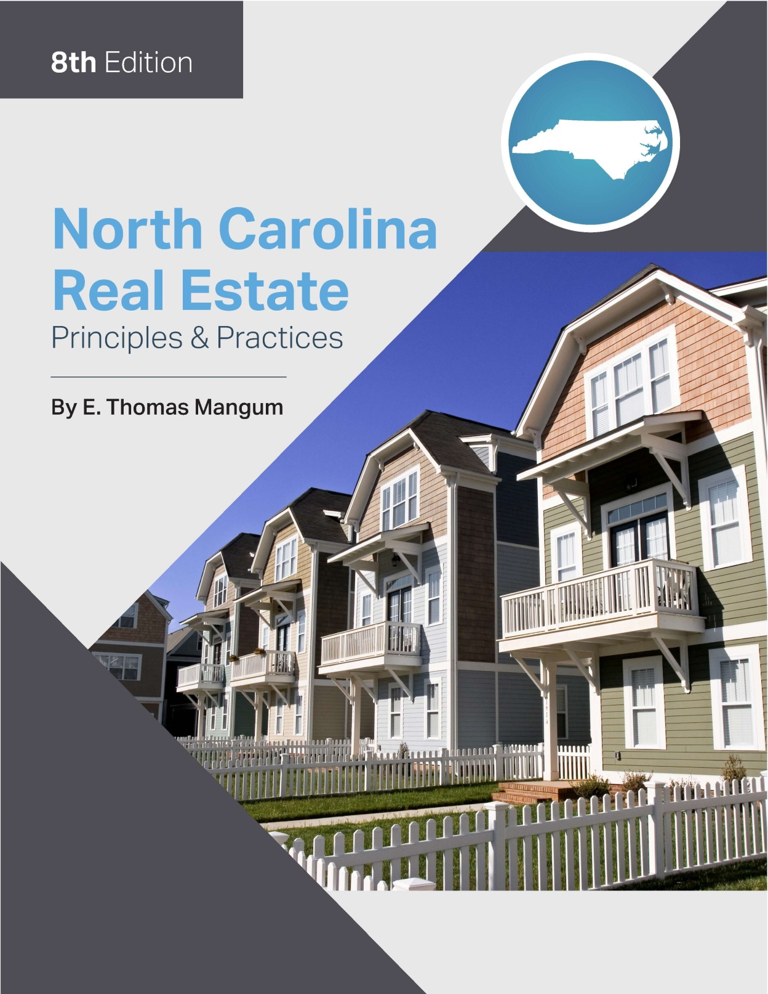

Slide 2
Chapter 5
Land Use Controls
Learning Objectives
Describe the general methods of creating land use controls, including examples of public land use controls as well as private restrictions.
Describe zoning concepts, including terminology, authority, purposes, and procedures.

Slide 3
Chapter 5
Land Use Controls
Historical Developments of Land Use Controls
1848
Supreme Court recognized and upheld restrictive covenants regulating land use in residential subdivisions.
1926
Supreme Court upheld the validity of zoning ordinances, making public land use controls legally reliable.
1987
Zoning of land that prohibits all use, even temporarily, amounts to the “taking” of land and requires compensation of the owner.

Slide 4
Chapter 5
Land Use Controls
Importance to Real Estate Practitioners and Buyers
All land is subject to land use controls, both public and private.
The agent has a duty to “discover and disclose” to the buyer any factors that may currently (or in the future) affect a given property.
Given the buyer’s intended use of the property, the agent must be aware of any land use controls that would limit that intended use.

Slide 5
Chapter 5
Public Land Use Controls
Planning and Zoning
Enabling Legislation
the delegation of authority from the North Carolina General Assembly to the local municipalities
Zoning
Implements or enforces city or county planning:
to provide for orderly growth of a community.
to result in greatest social and economic benefit to the community.
Local Ordinances
Local ordinances vary widely.
Agents should be familiar with the local ordinances where they operate.

Slide 6
Chapter 5
Planning and Zoning
Types of Zones
Zoning districts and codes can be confusing.
Keep a reliable reference source on:
current zoning codes.
classification charts.
tables of permitted use
Common zones:
Residential
Multiple use or cluster zoning (provides for planned unit developments)
Commercial
Light manufacturing
Heavy industrial

Slide 7
Chapter 5
Planning and Zoning
Terminology
Non-conforming use
A use preexisting before the ordinance came into effect; therefore, is allowed to continue.
Use cannot be changed or enlarged.
Illegal use:
a use that is contrary to the existing ordinance at the time the use is instituted
never becomes legal
Zoning Amendments:
an actual change in the zoning code itself
sometimes difficult to persuade a city to change its zoning code

Slide 8
Chapter 5
Planning and Zoning
Terminology
Variance:
permitted exception from specific requirements of zoning ordinance
established by appeal of special hardship
process of obtaining variance may be difficult and unpredictable
Special use (exception):
The use is already provided for in the code; therefore, is automatically approved.
Overlay districts:
zoning device that superimposes one zoning area over another
Example: Superimposing flood or historic zones over parts or all of existing zones

Slide 9
Chapter 5
Planning and Zoning
Terminology
Historic preservation:
city zoning regulations to preserve the irreplaceable historic legacies of architecture
requires approval for any material modification of the exterior
Aesthetic zoning:
an area can be regulated for essentially aesthetic reasons
application of historic preservation
Spot zoning:
the rezoning of a single property
considered illegal in North Carolina unless a reasonable basis for it can be clearly demonstrated

Slide 10
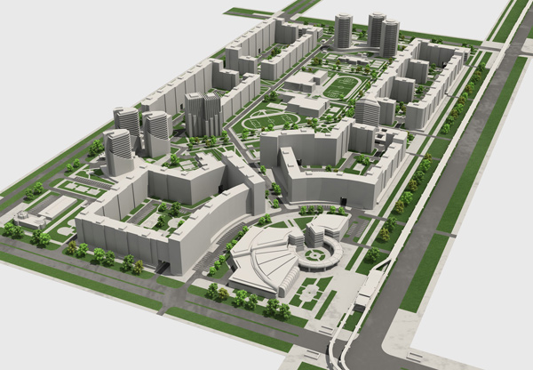
Chapter 5
Public Land Use Controls
Urban and Regional Planning
Urban and Regional Planning (Long Range Planning)
takes into account wide areas or multi-county regions
uses zoning as a local method to implement the overall plan

Slide 11
Chapter 5
Public Land Use Controls
Subdivision Regulations
The state empowers local governments, cities, and counties to regulate the creation of subdivisions within their particular jurisdictions.
Purpose of subdivision regulations:
to protect purchasers of property within the subdivisions
to protect the taxpayers in the city or county from significantly increased tax burdens
to determine demand for services generated by a new subdivision which potentially could increase taxes

Slide 12
Chapter 5
Public Land Use Controls
Subdivision Regulations
Subdivision ordinances typically address the following requirements:
Streets must be a specified width, be curbed, have storm drains, and not exceed certain grades.
Lots may not be smaller than a specified size.
Homes must follow the stipulations for single family or multi-family dwellings.
Utilities, including water, sewer, electric, and telephone, must be available to each lot.
All houses must abide by the setback minimum standards.
Adequate area drainage must provide for runoff of rainfall to avoid damage to adjacent properties.

Slide 13
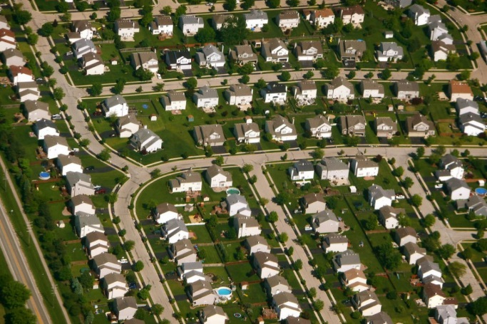
Chapter 5
Public Land Use Controls
Subdivision Regulations
Development:
Developers must obtain the approval of the appropriate officials.
Developers must record the final subdivision plat on the public record
before development can begin.
Lots cannot be placed under contract until after preliminary approval.

Slide 14
Chapter 5
Public Land Use Controls
Subdivision Regulations
Lots may be placed under contract between preliminary and final approval subject to the following:
copy of preliminary map must be attached.
notify buyer or lessee of the following (in conspicuous manner):
final plat is not yet recorded.
no obligation by any government body exists as to final plat approval.
final recorded plat may differ from preliminary plat.
buyer or lessee has right to terminate contract without penalty if there is a material difference between the preliminary and final recorded plats.

Slide 15
Chapter 5
Public Land Use Controls
Subdivision Regulations
The buyer or lessee has at least 5 DAYS to close after receiving from the seller or lessor a copy of a final recorded plat provided the preliminary and final plats have no material difference.
The buyer has 15 days after receiving the final recorded plat to terminate the contract without penalty provided the preliminary and final plats have material differences.

Slide 16
Chapter 5
Public Land Use Controls
Building Codes:
protect the public
regulate such things as:
Materials used in construction
Electrical wiring
Fire and safety standards
Sanitary equipment facilities
Require a permit be obtained from the appropriate local government authority BEFORE the construction or renovation of any property is begun.
A Certificate of Occupancy (CO) is issued after final inspection.
CO permits the occupation of the structure by tenants or the owner.

Slide 17
Chapter 5
Regulation of Special Land Types
Highway Access Controls
Government is allowed to condemn certain areas of a property for connection to the highway.
Compensation must be given to the present owner.
Any access restrictions must be disclosed to future grantees.

Slide 18
Chapter 5
Regulation of Special Land Types
Interstate Land Sales Full Disclosure Act
purpose -prevent fraudulent marketing schemes when land is sold by misleading sales practices on a sight-unseen basis
Developer must file statement of record with HUD before offering unimproved lots in interstate commerce by telephone or mail.
before purchase contract is signed- Printed property report to each purchaser or lessee, which discloses specific information about the land

Slide 19
Chapter 5
Regulation of Special Land Types
Interstate Land Sales Full Disclosure Act
Exemptions from this act include:
subdivisions in which the lots are 5 acres or more.
subdivisions of fewer than 100 lots are exempt from registration.
subdivisions of fewer than 25 lots are exempt from registration and antifraud provisions.
lots offered exclusively to building contractors.
lots on which a building exists or where contract obliges the lot seller to construct a building within 2 years.
Penalties for violations include a fine of up to $5,000 and up to 5 years in prison. Some violations are considered felonies.

Slide 20
Chapter 5
Private Land Use Controls
Individual Deed Restrictions
Individual deed restrictions exist in the form of covenants or in the form of conditions.
Covenant
a promise in writing
exists in a deed to benefit property that is sold or to benefit a property that is retained
enforced by a suit for damages or by injunction
These restrictions are covenants that run with the land, meaning that they move with the title in any conveyance.

Slide 21
Chapter 5
Private Land Use Controls
Individual Deed Restrictions
Conditions
restrictions that provide for a reversion of title if they are violated
If a condition is violated, ownership reverts to the grantor, his heirs, or assigns.

Slide 22
Chapter 5
Private Land Use Controls
Restrictive/Protective Covenants
Restrictions are placed on the use of land by the developer of a residential subdivision.
The covenants are promises on the part of the purchaser to limit their use of their property to comply with the requirements of the covenants.

Slide 23
Chapter 5
Private Land Use Controls
Termination of Covenants – terminated in the following ways:
expiration of the time period for which the covenants were created
unanimous vote of the property owners to terminate the covenants
changes in the character of the subdivision that make it unsatisfactory for the type of use specified by the covenants
failure to enforce restrictions on a timely basis
The right to enforce particular restrictions may be lost by abandonment.

Slide 24
Chapter 5
Private Land Use Controls
Enforcement of Covenants
Private land use controls are enforced by public law but not by public agencies.
Enforcement is accomplished by the action of a court, known as injunction.
North Carolina Planned Community Act- public act to enforce private land use controls by statute rather than civil action.
An individual property owner can enforce the restrictions. It does not take a majority.

Slide 25
Chapter 5
Responsibility of Real Estate Agents
Agent Responsibilities Regarding Potential Land Use Problems
Agent must recognize potential problems with and disclose appropriate information about:
Zoning
Flood hazards
Restrictive covenants
Major highway changes
When in doubt, advise principal to check with legal counsel or appropriate government or private entity.

