Slide 2
Chapter 6
Environmental Issues in Real Estate
Learning Objectives
Understand the health risks associated with lead poisoning especially from lead-based paints
Understand the health risks associated with asbestos
Understand the health risks associated with formaldehyde, including urea-formaldehyde
Understand the health risks associated with toxic mold
Understand the health risks associated with leaking underground storage tanks
Understand how to reduce the health risks associated with each of the above
Understand the basic elements of the Comprehensive Environmental Response, Compensation, and Liability Act (CERCLA)

Slide 3
Chapter 6
Environmental Issues in Real Estate
Real estate agents must have a good basic knowledge of the various environmental issues that face the typical homeowner in today’s market.
Lead-based paint
Asbestos
Radon
Formaldehyde
Toxic mold
Leaking underground storage tanks

Slide 4
Chapter 6
Environmental Issues in Real Estate
Lead Poisoning
Lead-based paint= lead contamination
Banned for residence use since 1978.
Results in damage to the central nervous system.
Often not diagnosed until many years after exposure
EPA pamphlet “Protect Your Family From Lead In Your Home” must be given to buyers and tenants before purchase/lease.

Slide 5
Chapter 6
Environmental Issues in Real Estate
Lead Poisoning
Three groups are particularly at risk:
Children under the age of 6
Women who are pregnant
Women of child-bearing age
N.C. Lead-based Paint Management Program (LHMP) requires certified contractor when more than 6 sq. ft. (interior) or less than 20 sq. ft. (exterior) is disturbed.

Slide 6
Chapter 6
Environmental Issues in Real Estate
Lead Poisoning
The Residential Lead-Based Paint Hazard Reduction Act:
Requires disclosure of known lead-based paint hazards.
Requires disclosure of records or reports pertaining to lead-based hazards.
North Carolina has developed their own form regarding lead-based paint disclosure.
Another requirement of the act is that purchasers be given at least 10 days to undertake a lead-based paint assessment and testing, although this right can be either waived or extended.

Slide 7
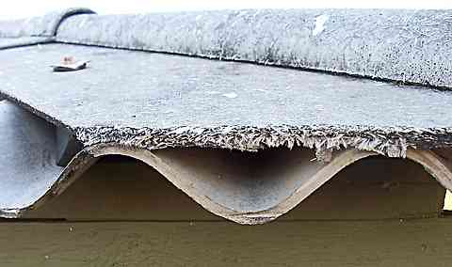
Chapter 6
Environmental Issues in Real Estate
Asbestos
Asbestos is fibrous material used for its strengthening ability and for heat and fire resistance.
Effectively banned in 1978
Health risks from tiny particles trapped in lungs
Common method to reduce health risks is to encapsulate

Slide 8
Chapter 6
Environmental Issues in Real Estate
Asbestos
Two types:
“Friable” refers to asbestos that will become airborne particles if disturbed (ex- old insulation)
“Non-friable” will not become airborne if contact is made
(ex- flooring, siding, roofing)
If removal is desired, it should be undertaken only by state-licensed asbestos abatement contractors who will dispose of the asbestos in accordance with state environmental requirements.

Slide 9
Chapter 6
Environmental Issues in Real Estate
Radon
Radon is a colorless, odor-less radio-active gas naturally from decaying uranium deposits
second leading cause of lung cancer
gets into home through cracks and around pipes
measured in picocuries. EPA considers 4.0 picocuries maximum acceptable level
The North Carolina Real Estate Commission considers that a radon reading of 4.0 or higher is a “material fact” and must be disclosed by the broker.

Slide 10
Chapter 6
Environmental Issues in Real Estate
Radon
Many builders today are installing radon mitigation systems in order to be proactive.
Brokers should determine whether any mitigation system was installed as a proactive measure or in an effort to reduce high levels of radon.

Slide 11
Chapter 6
Environmental Issues in Real Estate
Formaldehyde
Formaldehyde is a colorless gas emitted by common construction materials and products within the home.
can be found in drapery, linens, furniture
health hazards could include skin rash, watery eyes
could trigger asthma attacks

Slide 12
Environmental Issues in Real Estate
Formaldehyde
remediation typically includes ventilation
effects normally dissipate over time
If effects are from building materials (paneling, plywood…) removal might be necessary and are likely to be disruptive to homeowner.

Slide 13
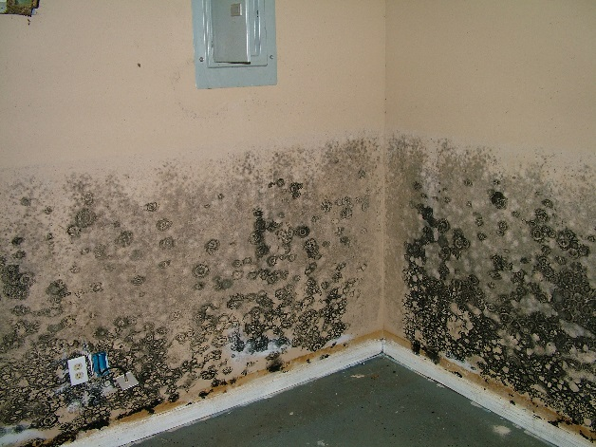
Chapter 6
Environmental Issues in Real Estate
Toxic Mold
Toxic Mold:
can grow without the presence of light
can grow virtually anywhere in the presence of moisture, a food source, and mold spores
Health risks include respiratory problems and perhaps severe allergic reactions.

Slide 14
Chapter 6
Environmental Issues in Real Estate
Toxic Mold
Remediation for small amounts can be a simple as drying out an area and washing with bleach and water solution. Professionals might be needed for larger contamination.
Insurance companies often refuse to extend coverage to homes that have a history of water damage claims.

Slide 15
Chapter 6
Environmental Issues in Real Estate
Leaking Underground Storage Tanks
North Carolina Leaking Petroleum Storage Tank Cleanup Act was enacted to regulate the installation of underground storage tanks and control the risk of leakage and discharge.
Focus is on storage tanks containing hazardous substances
Substances include gas, oil, pesticides, and solvents used in commercial and home installations.
Property owners may face fine and penalties for improper installation and leakage even if they did not install

Slide 16
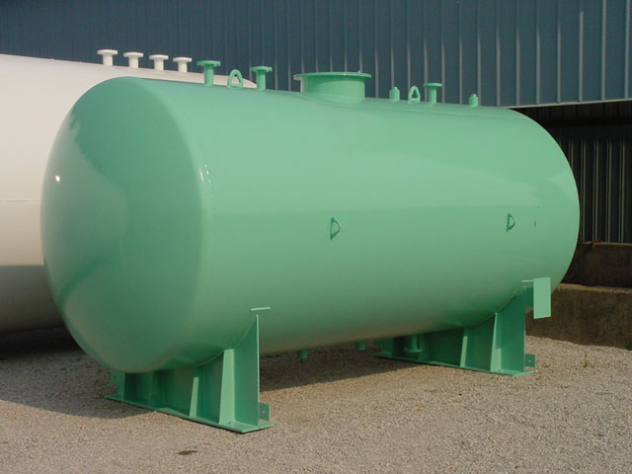
Chapter 6
Environmental Issues in Real Estate
Leaking Underground Storage Tanks
Any property that was originally constructed before the 1970’s needs to be inspected to determine whether an underground tank is remaining, and for those that have been removed previously, to determine whether any contamination had occurred.

Slide 17
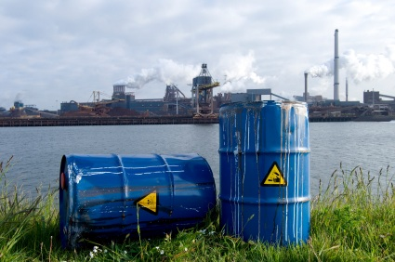
Chapter 6
Environmental Issues in Real Estate
Comprehensive Environmental Response, Compensation, and Liability Act (CERCLA)
Purpose is to detect and clean-up hazardous waste sites.
Commonly known as the “Superfund”
A land owner is responsible for hazardous waste problems on his property even when the problem did not originate there.
Innocent Landowner Immunity

